Slide 1
Self-excited forces formulation

Slide 2
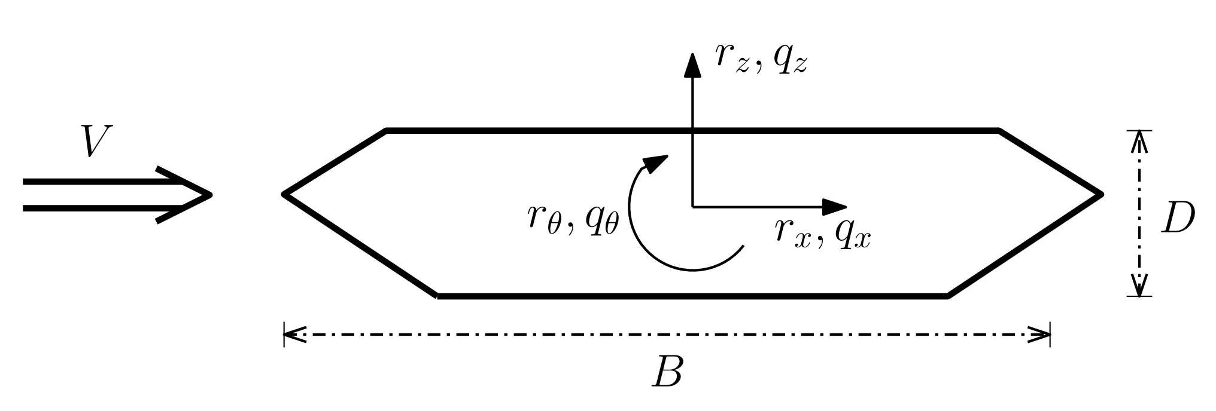
Distributed forces on an element in wind tunnel coordinate system:
Transformation to local element coordinate system (where x goes out, y goes right):
Transformation to global coordinate system:

Slide 3
Distributed forces now becomes:
Integration to nodal forces:
Transformation to global coordinate system:
Element contribution to full force vector:

Slide 4
Element contribution to modal load vector:
Linear integration result:

Slide 5
Rational function transfer function:
Linear integration result (modal contribution from one element):

